Slide 1
Java Basic Input and Output

Slide 2
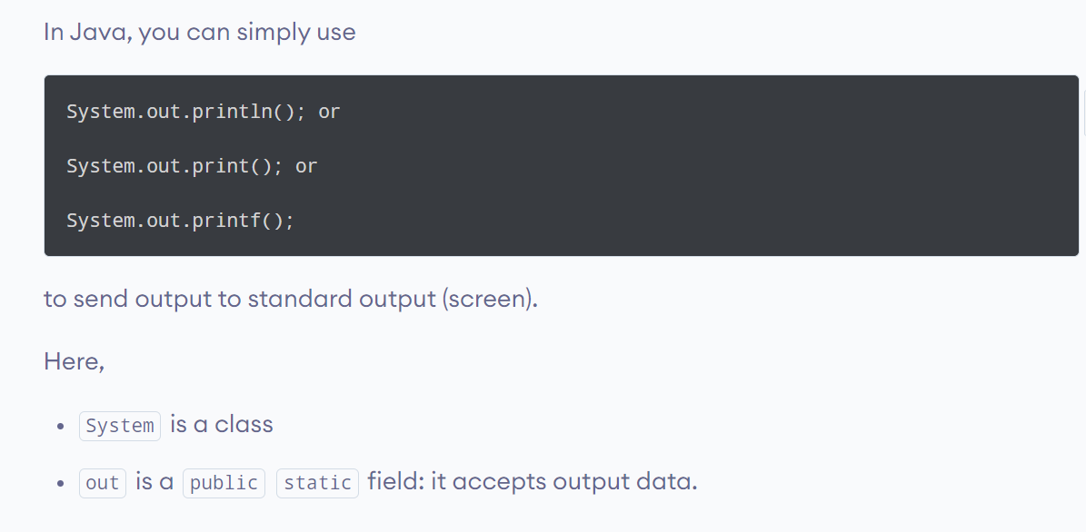
Java Output

Slide 3
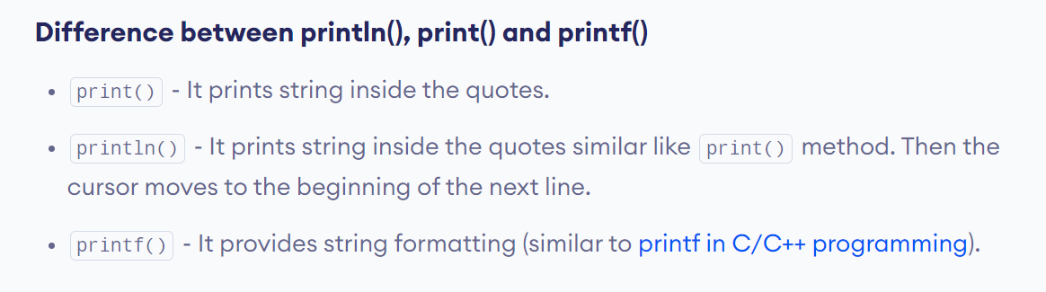
Difference between println(), print() and printf()

Slide 4
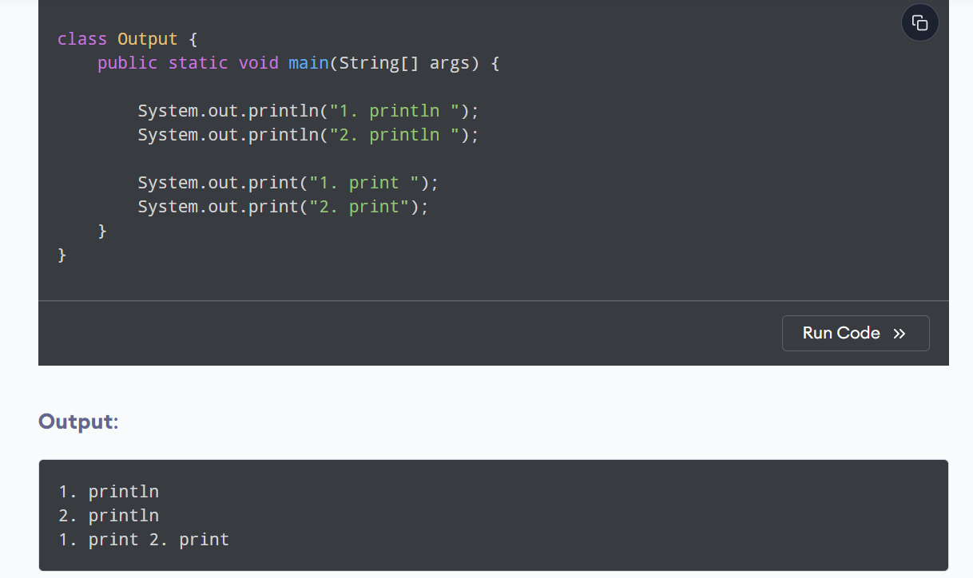
Example

Slide 5
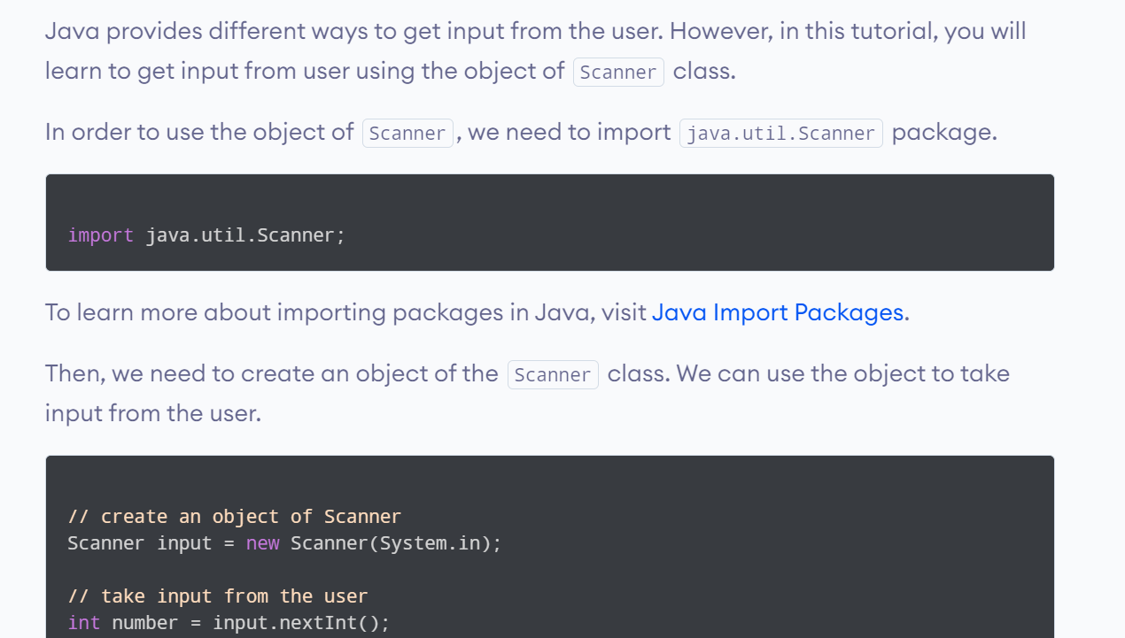
Java Input

Slide 6
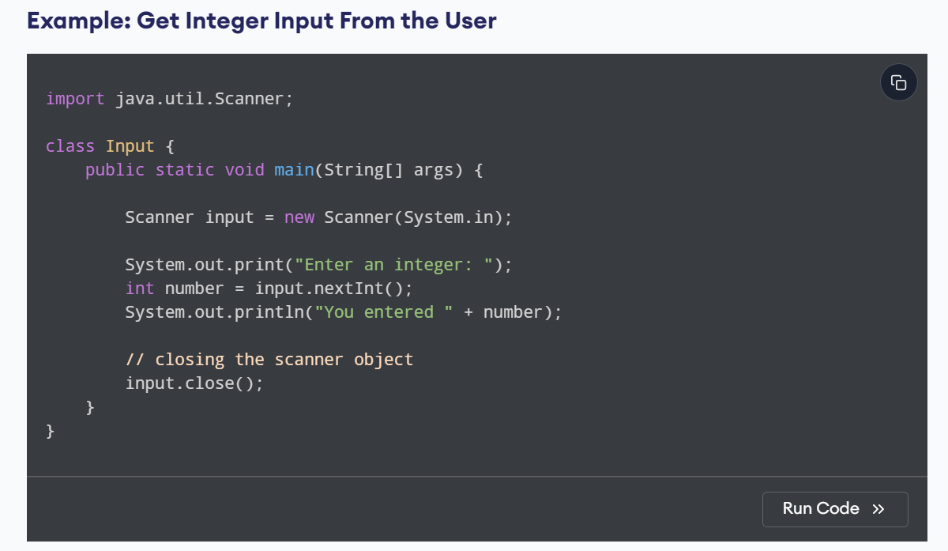

Slide 7
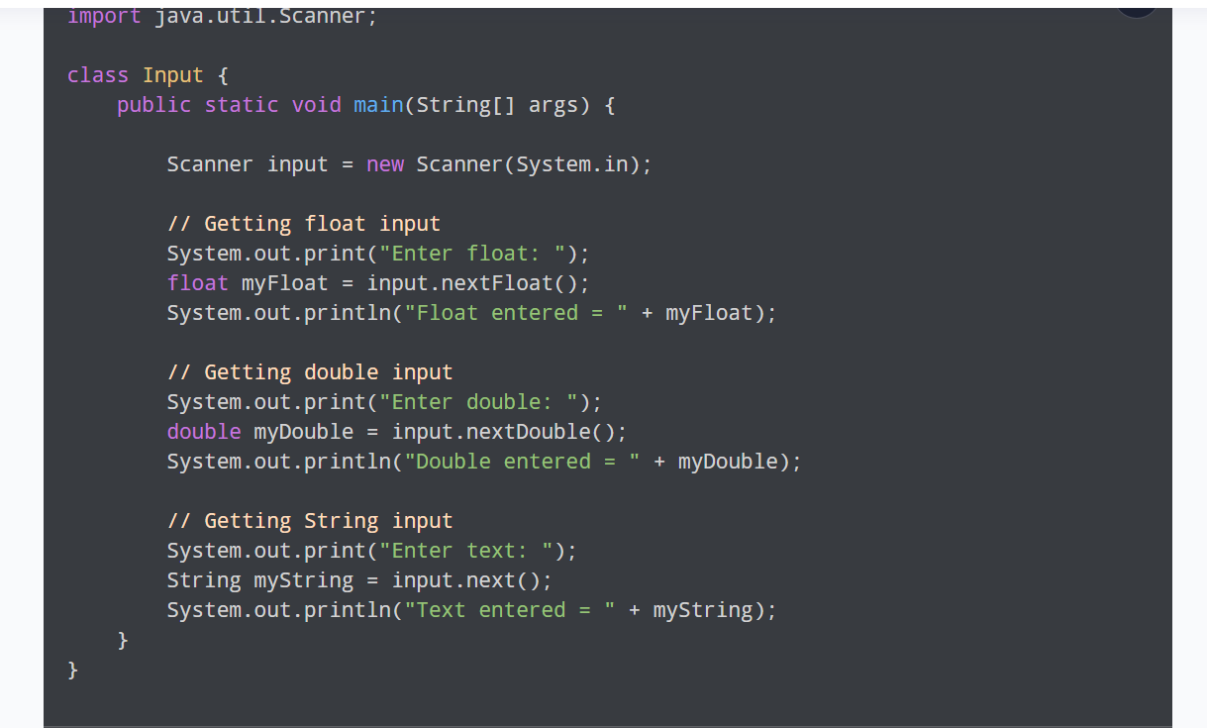
Example: Get float, double and String Input

Slide 8
Lab Exercise
Multiplication of two floating point numbers
Displaying ASCII Value of a Characters ( Char ch=sc.next().Char At(0);)
Swapping of two numbers
Computing Quotient and Reminder
Displaying details of a student

